Slide 1
Intuitive Grocery List
TEAM MEMBERS :
POOJA V KADAM
VENKAT RAMAN
VISHAL HOSAKERE

Slide 2
PROJECT GOAL
To develop an App which takes the Grocery List as input, along with location input and suggests the nearest possible store where the groceries can be purchased.
An app similar to Yelp, providing users with the best possible suggestions for grocery needs.

Slide 3
THE IDEA
Input: Notetaking input through keyboard
Location input utilizing GPS
Suggestions using google locations api
Reminders option

Slide 4
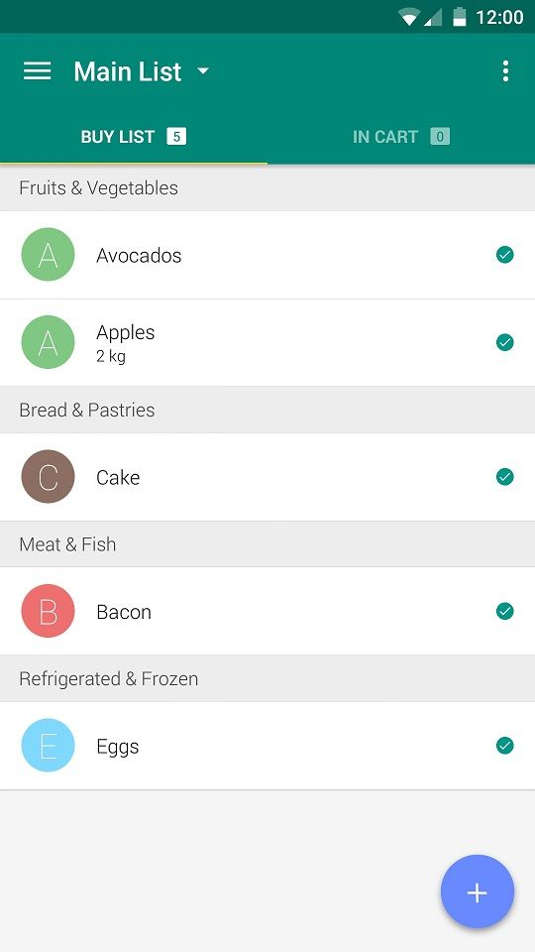
BEST CASE
Itemize grocery list by recognizing text from previous purchases.
Sync and share your shopping list with others.

